Slide 1
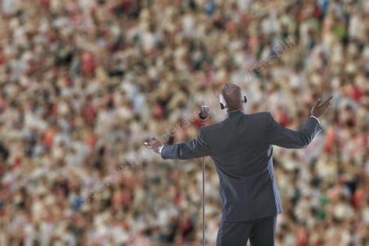
Managing the Public and the Corporate Reputation
Chapter 19
©2020 McGraw-Hill Education. All rights reserved. Authorized only for instructor use in the classroom. No reproduction or further distribution permitted without the prior written consent of McGraw-Hill Education.

Slide 2

The General Public1
An organizational stakeholder composed of individuals and groups found in society.
The public may …
Companies should be aware of how their actions may be portrayed in the media.
Notes:
An organizational stakeholder composed of individuals and groups found in society.
The general public affects the firm through its opinions of the firm’s activities or performance, which in turn help shape the firm’s public image or reputation.
The public may utilize its own stakeholder networks, and engage with government agencies, special interest groups, or the media:
To demand a certain level of performance.
To condemn or praise a firm.
Companies should be aware of how their actions may be portrayed in the media.
Through the media, the firm can:
Establish its reputation.
Repair a tarnish image.
Managing its public relations.
Address an organizational crisis.
Engage with multiple stakeholders in a variety of ways.

Slide 3

The General Public3
Media is understood as the collective means of communicating to an audience.
Notes:
Media is understood as the collective means of communicating to an audience.
Traditional media:
Television.
Radio.
Newspapers.
Modern media:
Internet.
Social media.

Slide 4
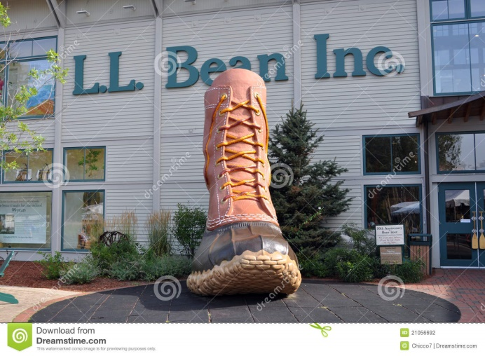
What is Reputation?
Corporate reputation
Corporate identity
Corporate image
Building a reputation can be thought of as a step-by-step process
Notes:
Corporate reputation: desirable or undesirable qualities associated with an organization or its actors that may influence the organization’s relationships with its stakeholders.
It relies on the collective perceptions of past actions, results and future prospects.
Corporate identity: the way in which an organization presents itself to an audience.
Corporate image: refers to the way organizational members believe others see the organization.
Few companies start with a reputation of distinction, simply because such a reputation must be built over time.
Building a reputation can be thought of as a step-by-step process:
Managers must first strive to offer significantly better products and services than its competitors.
Managers must aim to create and convey an identity: a consistent and compelling story about who the company is and what it stands for.
This story needs to grab the attention of the news media, online media, and opinion leaders in each.

Slide 5

Why Does Reputation Matter?
Respected organizations are generally more successful because they…
A sound reputation allows firms…
Notes:
Respected organizations are generally more successful because they:
Receive more opportunities to advance their interests.
Are given the benefit of the doubt in uncertain circumstances.
Are generally more immune to the long-term effects of harsh criticism than their less respected counterpart.
A sound reputation allows firms:
To charge premium prices.
To enhance their access to capital markets and investors.
To obtain better credit, trust, and social ratings.

Slide 6
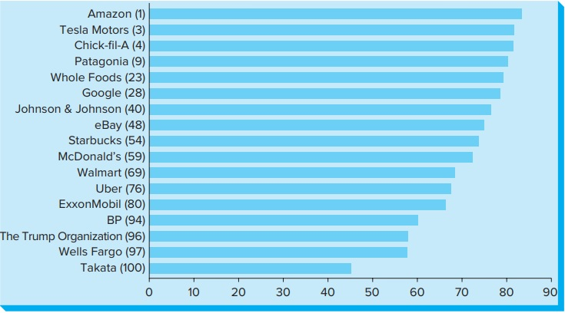
Select Companies from the 2018 Harris Poll Reputation Quotient Rankings
Figure 19.1
Copyright © McGraw-Hill Education. Permission required for reproduction or display.
Access the text alternative for these images.

Slide 7

The Public Relations Department1
Role
Role of media relations
Access to top managers
Notes:
Role: to manage the firm’s public image and, more generally, its relationship with the public.
This department may also be called media relations, since much of its work involves interacting with the media.
It does so through direct communications with the public (for example, through its website).
Indirect communications with them through various media outlets.
Most public relations officers have close links with top managers.

Slide 8

Public Relations in the Internet and
Social Media Age1
More and more people are finding their news, marketing, or other public relations information through Internet-related vehicles
Growing trend by younger generations to access information via social media
Social Media influencer
Some businesses decentralize their global public relations programs
Notes:
An organization works to enhance its public image by seeking positive coverage in news reports and feature stories, or by paid advertisements via:
Television, radio, magazines, newspapers, or billboards.
More and more people are finding their news, marketing, or other public relations information through Internet-related vehicles, such as:
Blogs, e-mails, social networks, podcasts, and other technology-based communication sources.
Coupled with the growing trend by younger generations to access information via social media or other new technology, businesses have turned to social media influencers to get their message out to the public.
Social Media influencer: an individual that has access to a large audience and can persuade others by virtue of their authenticity and reach.
When public relations strategies take on a global perspective, new challenges emerge.
Public relations managers must be sensitive to cultural disparities.
Some businesses decentralize their global public relations programs and establish officers in each of the locations where they have operations:
To ensure that the local public relations strategy is in tune with local customs and emerging issues.

Slide 9
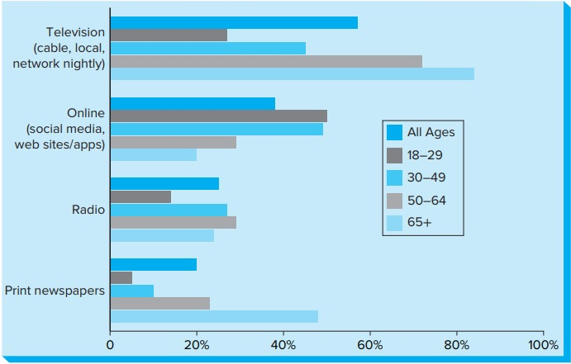
Public’s Access to the News by Platform
Copyright © McGraw-Hill Education. Permission required for reproduction or display.
Figure 19.2
Access the text alternative for these images.

Slide 10
Brand Management
A recognizable brand is one that can immediately signal to stakeholders how the company is different from its rival.
A corporation’s reputation is captured in a recognized and trusted name.
Notes:
Using techniques to increase the perceived value of a product line or brand over time.
A recognizable brand is one that can immediately signal to stakeholders how the company is different from its rival.
A corporation’s reputation is captured in a recognized and trusted name.
The company’s name and logo act as its signature, a sign that says they can be trusted to deliver exceptional value to customers.
Involves conveying what the product or service offers-the benefits, solutions to problems or simply an experience.

Slide 11

Crisis Management1
Crisis management
Corporate crisis
Notes:
Crisis management: process by which an organization deals with a major event that threatens to harm the organization, its stakeholders, or the general public.
Corporate crisis: a significant business disruption that stimulates extensive news media or social networking coverage.

Slide 12
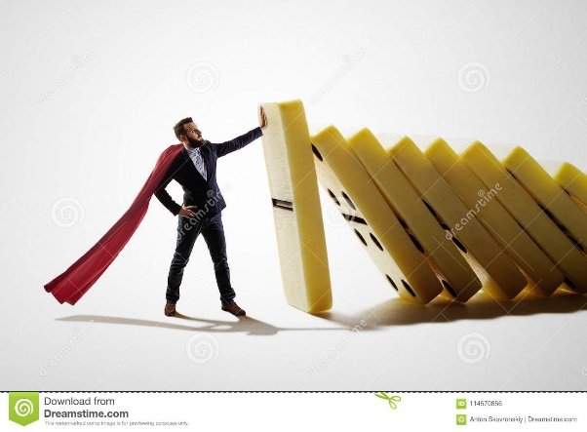
Crisis Management2
The Institute for Crisis Management breaks down corporate crises into these groups:
  “Acts of God”
  Mechanical problems
  Human errors
  Management decision or indecision
  Poor financial performance.
  Backlash
  Terrorism
Notes:
The Institute for Crisis Management breaks down corporate crises into these groups:
“Acts of God”—earthquakes, tornados, violent storms, volcanic eruptions.
Mechanical problems—breakdowns of or faulty equipment, metal fatigue.
Human errors—through miscommunication, improper employee behavior.
Management decision or indecision—often involving a cover-up or lack of urgency.
Poor financial performance.
Backlash against stance on controversial social or political issues.
Terrorism or other acts of violence against the company.

Slide 13
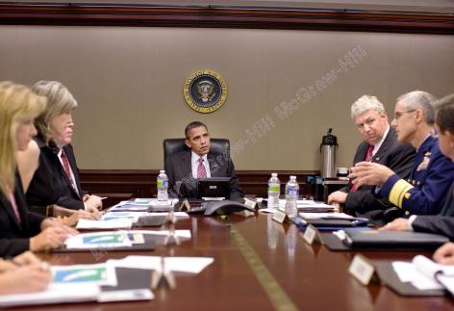
Effective Crisis Management Plan
Crisis Management Plan:
Get ready before the crisis
Communicate
Convey the message
Do the right thing.
Follow up
Notes:
Crisis Management Plan:
Get ready before the crisis hit by creating an internal communication system that can be activated the moment a crisis occurs.
Communicate quickly, but accurately.
Use the Internet to convey the message to minimize the public’s fears and provide assistance.
Do the right thing.
Follow up and, where appropriate, make amends to those affected.

Slide 14
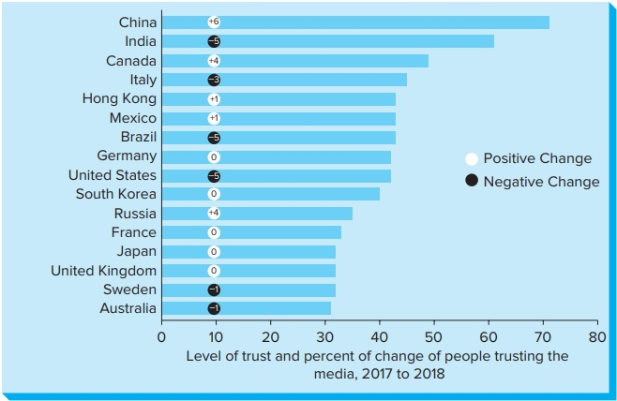
Declining Percentage of People Trusting the Media, 2017-2018
Copyright © McGraw-Hill Education. Permission required for reproduction or display.
Figure 19.3
Access the text alternative for these images.

Slide 15


Engaging Key Stakeholders with Specific Tactics: Executive Visibility1
The firm’s overall reputation is clearly on the agenda for the board of directors
Best techniques to assist a spokesperson to stay on point:
    Hooking
    Bridging
    Flagging
Notes:
The firm’s overall reputation is clearly on the agenda for the board of directors because of its effect on the firm’s products and profits.
Media communication experts generally give their clients the following advice:
Be honest.
Be current.
Be accessible.
Be helpful.
Be understanding.
Be cool, courteous, and professional.
Best techniques to assist a spokesperson to stay on point when challenged by a reporter with a tough question are the following:
Hooking: Grab the reporter’s attention by making a statement that influences the next question.
→ Example: “We are undertaking a program to correct the situation.”
Bridging: Answer the challenging question but quickly move on to the key message.
→ Example: “Yes, but…”, “What I can tell you is…”
Flagging: Emphasize key points and guide the reporter to them.
→ Example: “Your listeners may not know that…”

Slide 16

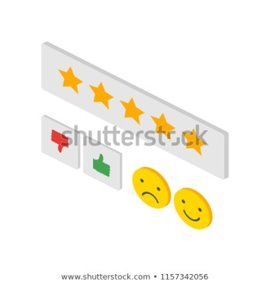
Engaging Key Stakeholders with
Specific Tactics:
User-Generated Content
Paid Content
Event Sponsorship
Public Service Announcements
Image Advertisements
Notes:
Engaging Key Stakeholders with Specific Tactics: User-Generated Content
User-generated content: sources of information provided by users through social media sites like Facebook, YouTube, Twitter and Instagram.
Managers who understand the growing importance of user-generated content will communicate much more effectively than those who do not.
User-generated sites can be used effectively for brand, issue, and crisis management.
Example: Hashtags on Twitter.
However, these campaigns can sometimes result in the hashtag becoming what has been called a bashtag.
Engaging Key Stakeholders with Specific Tactics: Paid Content
When firms pay to have online or print publishers create and distribute their content.
Creating high quality content is very important for a firm’s brand and image management, but its distribution is equally vital.
Best known are promoted feeds on Facebook, LinkedIn and Twitter.
Other less well-known options: CSRWire, Outbrain, Taboola and Disqus.
Understanding the nuances of the distribution process can be the difference between getting ignored or standing out.
Engaging Key Stakeholders with Specific Tactics: Event Sponsorship
Sponsor an event with the company’s name and logo.
According to Jeff Haden at Inc.com, “when you sponsor an event your focus should always be on the quality rather than the quantity of brand impressions.”
Engaging Key Stakeholders with Specific Tactics: Public Service Announcements
Since 1942, the Ad Council has been the leading producer of public service announcements (PSAs):
Addressing critical social issues for generations of Americans and global citizens.
Businesses have discovered that public service announcements are an effective means for promoting various social issues or topics that resonate with the public.
Example: The Ad Council created the #ThatsHarrassment project.
Engaging Key Stakeholders with Specific Tactics: Image Advertisements
Image advertisements are used to enhance their public image, create goodwill, or announce a major change such as a merger, acquisition, or new product line.
Focus on a public policy issue or piece of legislation.
Image ads promote the image, or general perception, of a product or service, rather than promoting its functional attributes.
They target the public’s emotions and seek to influence the consumers’ imaginations.

Slide 17
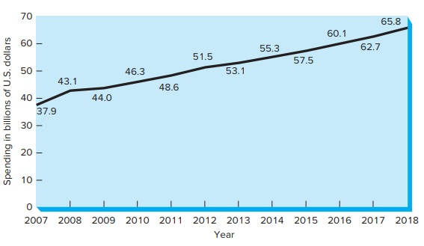
Global Sponsorship Spending, 2007-2018
Copyright © McGraw-Hill Education. Permission required for reproduction or display.
Figure 19.4
Access the text alternative for these images.

Slide 18
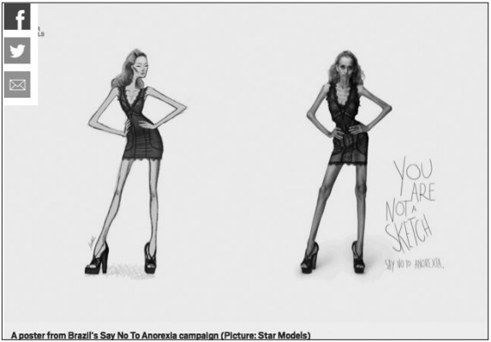
A Poster from Brazil’s Say No-Anorexia Campaign
Figure 19.5
Copyright © McGraw-Hill Education. Permission required for reproduction or display.
Access the text alternative for these images.

Slide 19
End of Main Content
Notes:
Closing slide.

Slide 20
Accessibility Content:
Text Alternatives for Images

Slide 21
Select Companies from the 2018 Harris Poll Reputation Quotient Rankings Text Alternative
The x-axis contains ten markers with numeric labels from left to right as follows: 0, 10, 20, 30, 40, 50, 60, 70, 80, and 90. The y-axis lists 17 company names from top to bottom along with their numerical ranking between 1 and 100 in parenthesis.
For each company listed, a bar extends from left to right indicating the firm’s reputation score.
The company list reads as follows:
Amazon ranked 1 with a score of about 83; Tesla Motors ranked 3 with a score of about 82; Chick-fil-A ranked 4 with a score around 83; Patagonia ranked 9 with a score near 80; Whole Foods ranked 23 with a score around 79; Google is ranked 28 with a score around 78; Johnson & Johnson ranked 40 with a score near 76; eBay ranked at 48 with a score of 75; Starbucks ranked at 54 with a score around 73; McDonald’s ranked 59 with a score near 72; Walmart ranked at 59 with a score near 69; Uber ranked 76 with a score around 68; ExxonMobile ranked 80 with a score around 67; BP ranked at 94 with a score near 60; The Trump Organization ranked 96 with a score near 58; Wells Fargo ranked 97 with a score near 58; Takata ranked 100 with a score around 45.
Return to slide containing original image.

Slide 22
Public’s Access to the News by Platform Text Alternative
The x-axis contains six markers with numeric percentages labeled as follows from left to right: 0, 20 percent, 40 percent, 60 percent, 80 percent, and 100 percent. The y-axis lists four media categories labeled from top to bottom as Television (cable, local, network nightly); Online (social media, web sites/apps); Radio; and Print Newspapers.
Each media category contains five different color bars representing the age groups. The age group bars are color coded as follows: dark blue is all ages; dark grey is from 18 to 29; medium blue is from 30 to 49; light gray is from 50 to 64; and light blue is 65 and over.
From top to bottom per media category, the bar values are as follows.
Access to news by Television all ages is about 58 percent; ages 18 to 29 is around 30 percent; ages 30 to 49 is about 50 percent; ages 50 to 64 is near 77 percent; ages 65 and over is about 85 percent.
Access to news Online for all ages is about 38 percent; ages 18 to 29 is around 53 percent; ages 30 to 49 is about 51 percent; ages 50 to 64 is near 30 percent; ages 65 and over is just below 30 percent.
Access to news via Radio for all ages is about 24 percent; ages 18 to 29 is around 15 percent; ages 30 to 49 is about 26 percent; ages 50 to 64 is near 28 percent; ages 65 and over is around 22 percent.
Access to news vis Print Newspapers for all ages is 20 percent; ages 18 to 29 is only about 5 percent; ages 30 to 49 around 9 percent; ages 50 to 64 about 22 percent; and ages 65 and over is just under 50 percent.
Return to slide containing original image.

Slide 23
Declining Percentage of People Trusting the Media, 2017-2018
Text Alternative
The x-axis indicates the percentage of trust in the media and contains nine markers with numeric labels from left to right as follows: 0, 10, 20, 30, 40, 50, 60, 70, and 80.
The y-axis lists 16 countries in descending order of trust from top to bottom. The graph contains a key showing a small round white circle as a positive change in trust level and a small black circle indicating a negative change. For each country, a bar denotes the overall percentage of trust. Positioned on each bar is a small black or white circle showing the amount of positive or negative change from 2017 to 2018.
From top to bottom the data reads as follows:
China shows over 70 percent of trust, up by six.
India has about 60 percent trust, down by five.
Canada has about 50 percent trust, up by 4.
Italy has a trust level of about 45, down by 3.
Hong Kong has a trust level of about 43 percent, up by 1.
Mexico has a trust level around 43 percent, up by 1.
Brazil shows a trust level near 43 percent, down by 5.
Germany has a trust level near 42 percent, no change.
The United States has a trust level around 42 percent, down by 5.
South Korea shows a trust level slightly over 40 percent, with no change.
Russian has a trust level of about 35 percent, up 4 points.
France has a trust level of about 33 percent, no change.
Japan shows a trust level of about 32 percent, no change.
The United Kingdom has a trust level at around 32 percent, no change.
Sweden shows a trust level near 32 percent, down by 1.
Australia has a trust level of about 31 percent, down by 1.
Return to slide containing original image.

Slide 24
Global Sponsorship Spending, 2007-2018 Text Alternative
The x-axis represents the year and contains 12 markers labeled from left to right as 2007 through 2018.
The y-axis shows spending in billions of U.S. dollars and is labeled from top to bottom as 70, 60, 50, 40, 30, 20, 10, and 0.
The rising line data is as follows:
2007 at 37.9, 2008 at 43.1, 2009 at 44, 2010 at 46.3, 2011 at 48.6, 2012 at 51.5, 2013 at 53.1, 2017 at 55.3, 2015 at 57.5, 2016 at 60.1, 2017 at 62.7, and 2018 at 65.8.
Return to slide containing original image.

Slide 25
A Poster from Brazil’s Say No-Anorexia Campaign
Text Alternative
It depicts a sketch of a very thin girl on the left. On the right, the real image of the girl is depicted. She has an anorexic appearance. Beside the image on the right, there is text that reads as follows:
You are not a sketch. Say no to anorexia.
Return to slide containing original image.

